Slide 1

Motors and Controllers
Module
Rohit Kumar

Slide 2
Contents
Title | Page
Types of Motors
AC Motors
DC Motors
DC Geared Motors
Servo Motors
Controller Circuit

Slide 3
AC Motors
DC Motors
DC Geared Motors
Servo Motors
Types of Motors

Slide 4
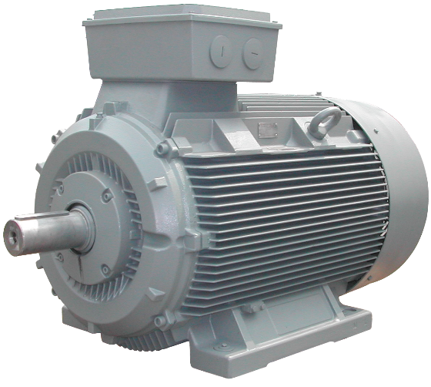
AC Motor
These are the motors which convert alternating signal into rotational motion
Examples are:
Water pumps
Ceiling Fan
Table Fan

Slide 5
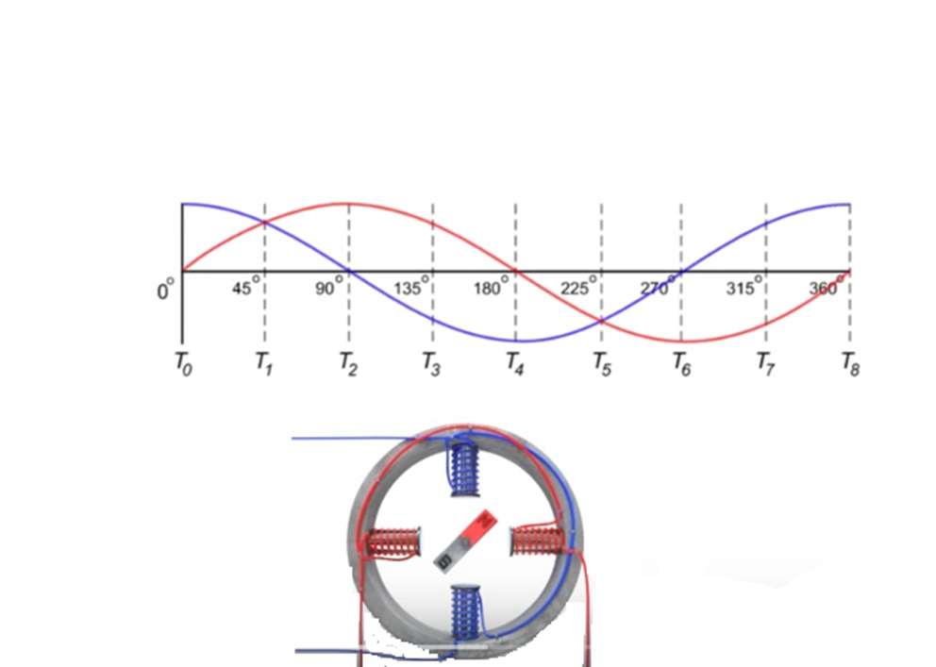
Working Principle of AC motor

Slide 6
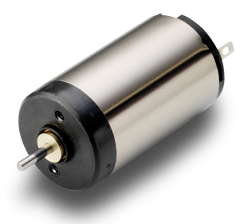
DC Motor
These are the motors which convert DC signal into rotational motion
In robotics applications they are preferred over AC motors as the motor and the complete circuit require same kind of supply, i.e. DC supply

Slide 7
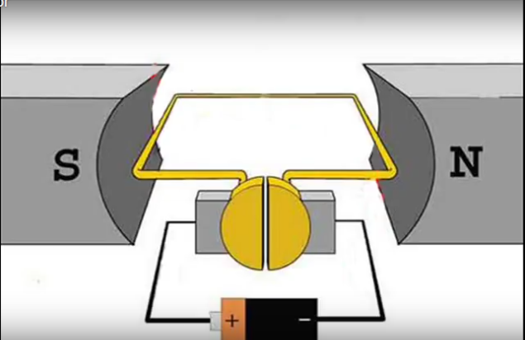
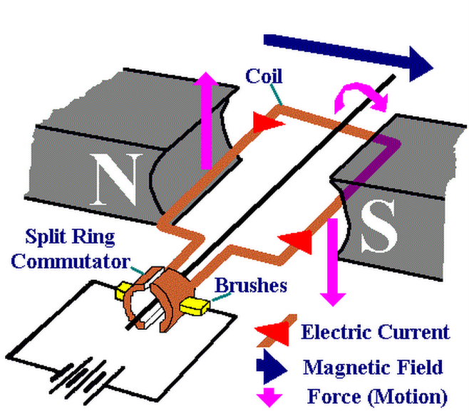
Working Principle of DC motor

Slide 8
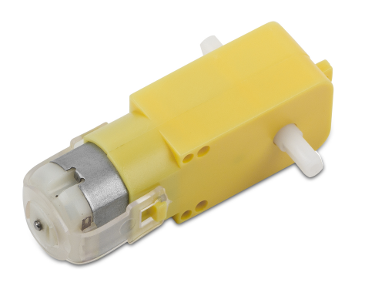
DC geared Motor
These are the DC motors having external gear arrangement attached with motor.
These are the motors which are most commonly used in robotics, as they have considerable torque.

Slide 9
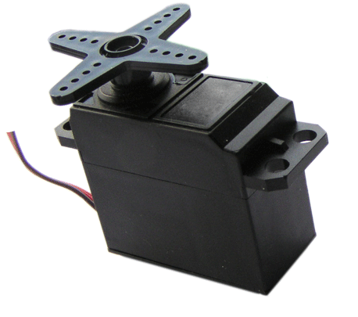
Servo Motor
Servo motors are the most powerful motors for robotic applications.
They comes in both variants, AC and DC.
They can change the direction with same supply.

Slide 10
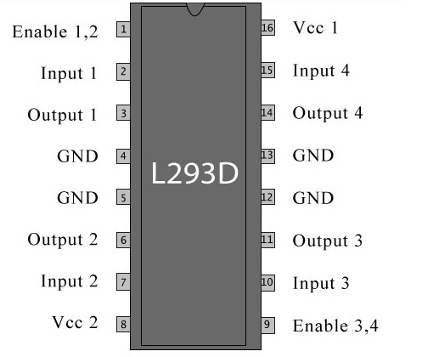
Controller Circuits
For both way motion (clockwise and anticlockwise) of one DC motor, an “H-Bridge” cam be employed.
For both way motion of two DC motors “dual H-Bridge IC L293D” can be employed.
They can change the direction with same supply.

Slide 11
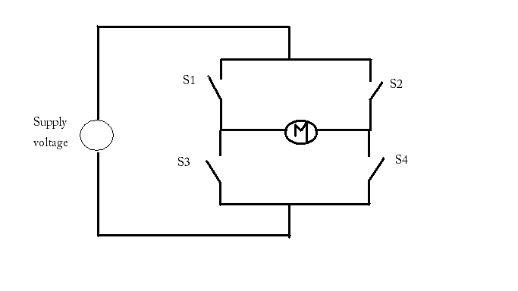
Controller Circuits
Only possible switch setting for rotation:
S1-S4 ON, S2-S3 OFF (for one direction).
S2-S3 ON and S!-S4 OFF (for other direction).

Slide 12
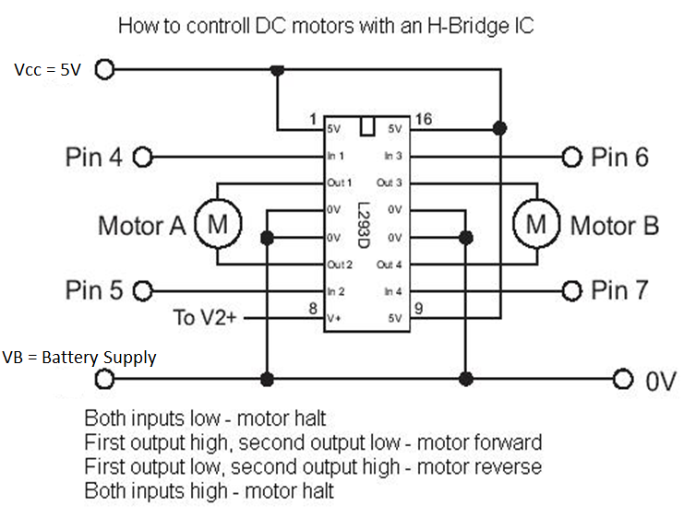
L293D motor driver IC

Slide 13
Thank You !
Contact US
Nitin Sinha
nitin.sinha@goSigmaWay.com
+1 727-394-4375
+91 7838188809
Debjani Mitra
debjani.mitra@goSigmaWay.com
+1 952-583-3449
+91 9339555636
Rohit Kumar
rohit.kumar@sigmaway.us
+91 7982577830
+91 7838021754

